Slide 1
Mesoscale convective systems and Global Precipitation Measurement (GPM)
Chie Yokoyama
Atmosphere and Ocean Research Institute (AORI), The University of Tokyo
Keynote lecture for Global km-scale Hackathon, Tokyo Node
@AORI, the University of Tokyo on May 15, 2025

Slide 2
Outline
1. Introduction of GPM & TRMM
2. Backgrounds on radar observation and mesoscale organized systems
3. Precipitation systems over East Asia in early summer
3-1 Statistical analyses
3-2 A case study on an organized precipitation system
4. Precipitation systems with quasi-stationary convective bands (QSCBs) around Japan in the warm season
5. Summary

Slide 3
1. Introduction of GPM & TRMM

Slide 4

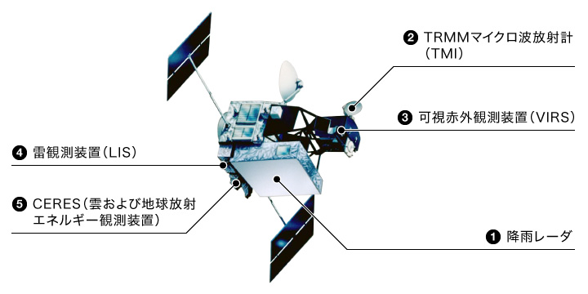
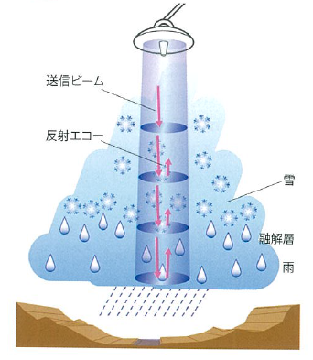
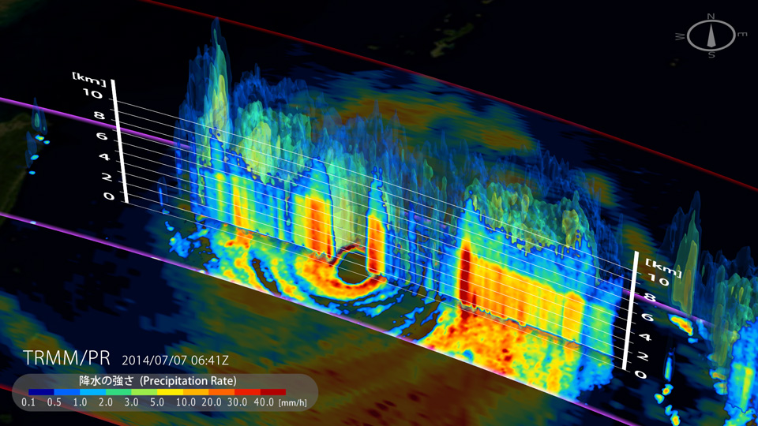
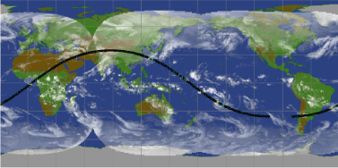
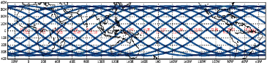
Tropical Rainfall Measuring Mission (TRMM) satellite 1997-2015
熱帯降雨観測計画（TRMM）衛星 1997～2014年
The world’s first spaceborne Precipitation Radar (PR)
TRMM Microwave Imager
→ Global measurement of 3-D precipitation structures over the tropics and subtropics (35°N-35°S)
Visible Infrared Scanner
Lightning Imaging Sensor
Clouds and the Earth’s Imaging Sensor
Super typhoon NEOGURI (08W) T1408
©JAXA
Precipitation Radar (PR)
Rainfall measurement from different aspects with onboard multi-sensors
©JAXA
©JAXA
Specs of PR (after the orbit boost)
・ Frequency: 13.8GHz ・ Swath width: 245km
・ Range resolution: 250m ・ Horizontal resolution: 5km
©JAXA
Non-sunsynchronous circular orbit →Observation of diurnal variations

Slide 5
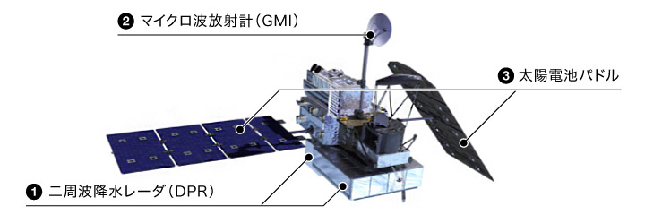
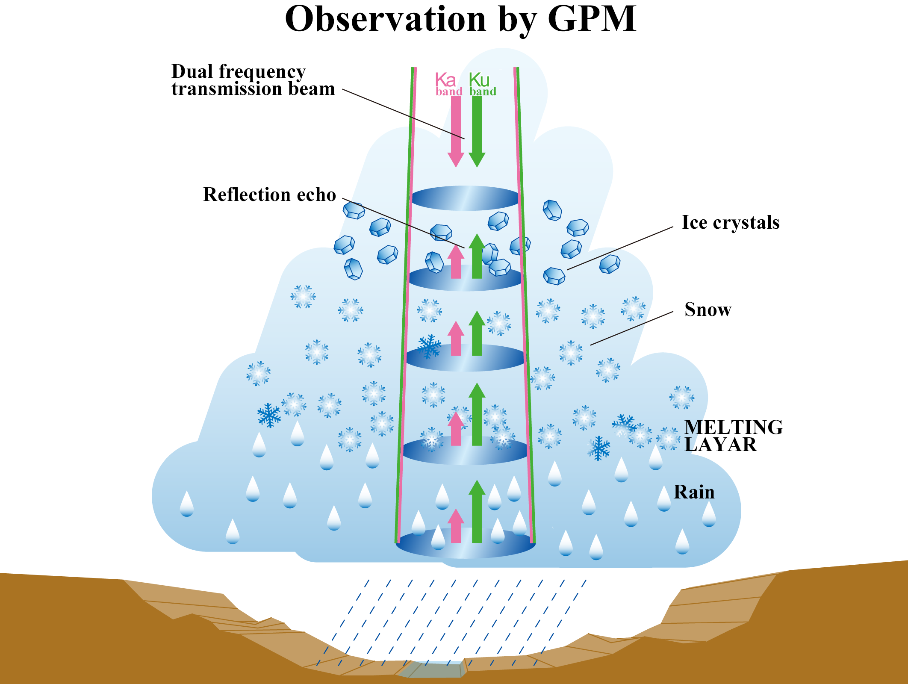
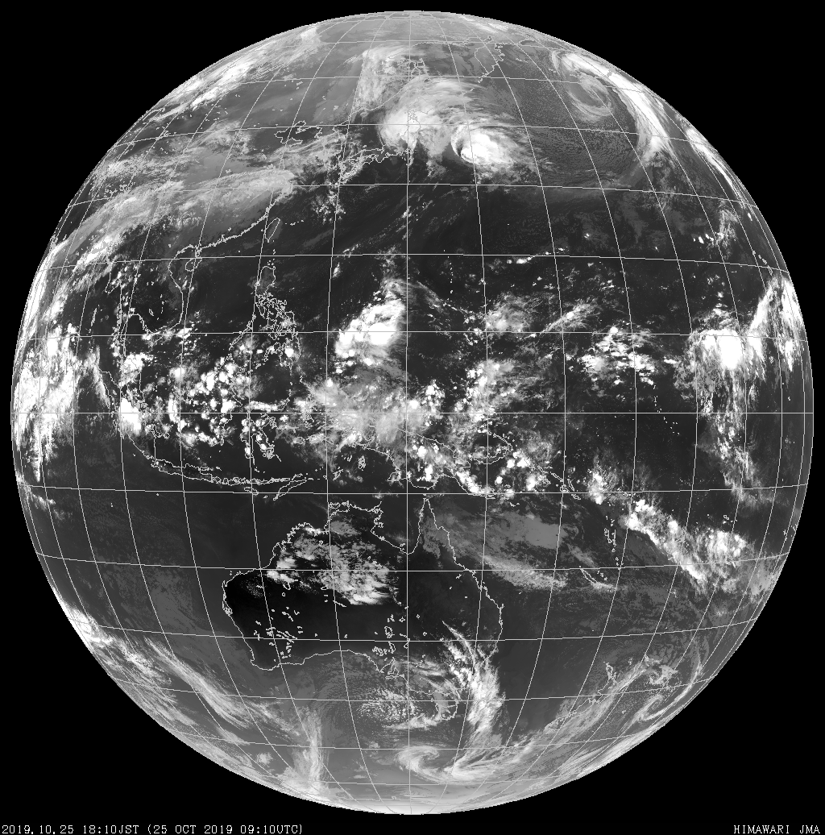
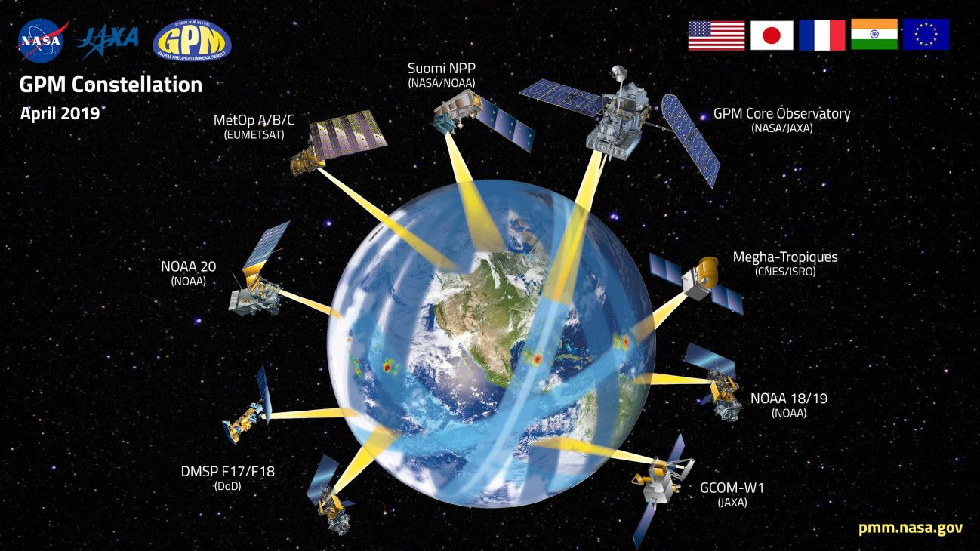
Global Precipitation Measurement (GPM) core satellite 2014-present
cf. Himawari-8 IR
Covered by GPM
©JAXA
Dual-frequency Precipitation Radar (DPR)
Ku-band (13.6GHz) & Ka-band (35.5GHz) radars
©JAXA
Provided by JMA
The GPM core satellite has the DPR, enabling 3-D measurement of precipitation ranging from heavy rainfall in the tropics to weak rain/snow in the midlatitudes over ~90% of the earth surface (65°N-65°S).
The GPM mission consists of the GPM core satellite and constellation satellites equipped with microwave radiometers under international cooperation.
GPM satellite constellation
©NASA GSFC

Slide 6
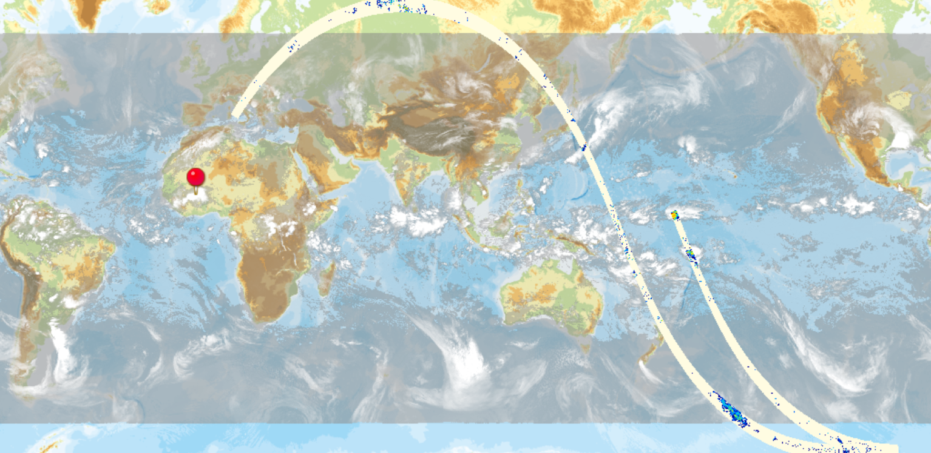
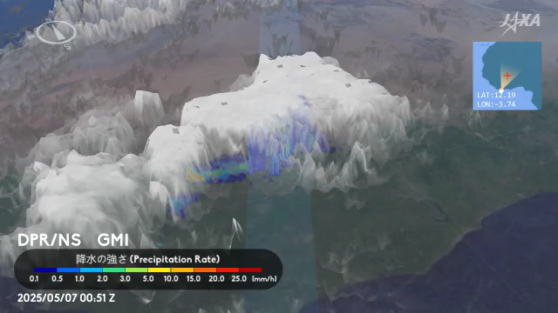
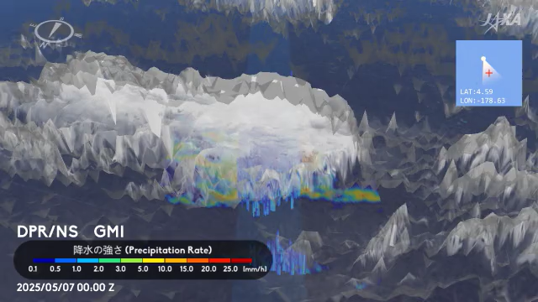
Today’s point: observation of 3-D precipitation structures from the space
2025.05.07 00-01Z
Spaceborne precipitation radars enabled statistical analyses of when/where/how a variety of precipitation systems occur.
Spaceborne radar measurement of inner structures of precipitation systems is useful for understanding of their mechanisms.
Central Africa
Pacific
JAXA 3D RAINFALL WATCH (https://www.eorc.jaxa.jp/GPM/3DRAIN_GLOBAL/index_j.html)

Slide 7
2. Backgrounds on radar observation and mesoscale organized systems

Slide 8
Radar observation: convective vs. stratiform
Convective (stronger, shorter time)
Stratiform (weaker, longevity)
Upright structure of strong echoes
Bright band near the melting level
Houze (1997)
Precipitation particles grow through collection of cloud water/ice in relatively strong updrafts (1-10m/s)
Snowflakes fall and become larger due to aggregation in weak updrafts, and then melt around the 0℃ level.

Slide 9
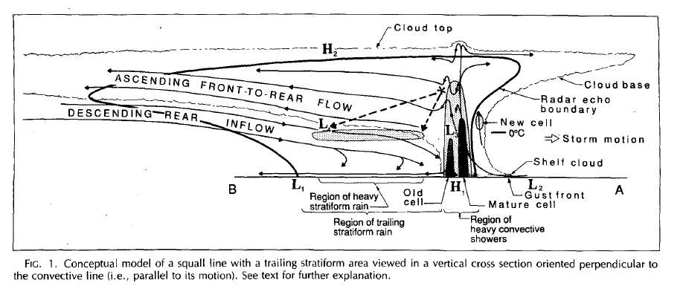
Radar observation: organized precipitation systems (e.g., MCS)
Schematics of MCS
Radar observation
Convective: upright echo
Convective
Stratiform
Houze and Betts (1981)
Houze (1989)
Stratiform: bright band
In organized systems, an extensive region of stratiform precipitation is sustained by supply of ice particles from convective regions and mesoscale circulations.
→Stratiform precipitation ratio (SPR) provides an indication of whether precipitation systems are organized.

Slide 10
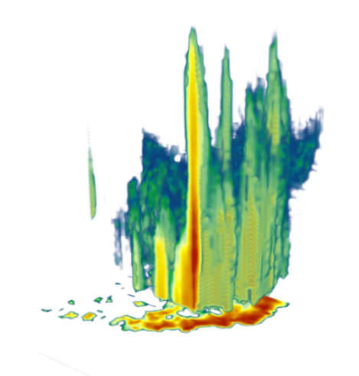
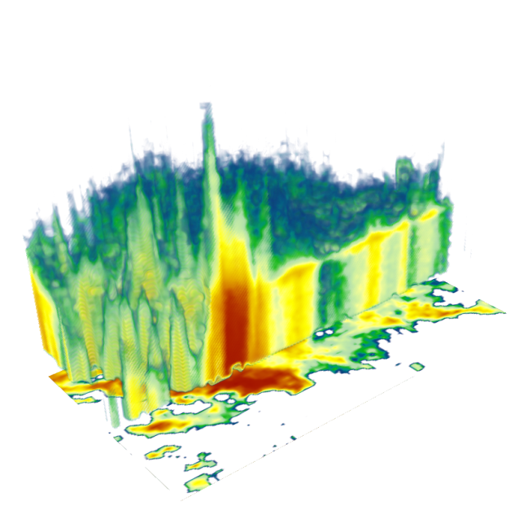
Analysis of precipitation events (PEs)
An approach to extract contiguous precipitation areas and analyze their characteristics
Easy to physically interpret relationships between precipitation and environments than a pixel-by-pixel approach
PE: defined by a contiguous area detected with a near-surface precip. rate ≥0.5mm/h in this talk
14km
7km
Plot by Dr. A. Hamada (U. of Toyama)
Area: smaller
Maximum 40-dBZ height (vigor of convection): taller
Stratiform precipitation ratio: smaller
Area: larger
Maximum 40-dBZ height (vigor of convection): lower
Stratiform precipitation ratio: larger
“Convective, tall system”
“Organized system”

Slide 11
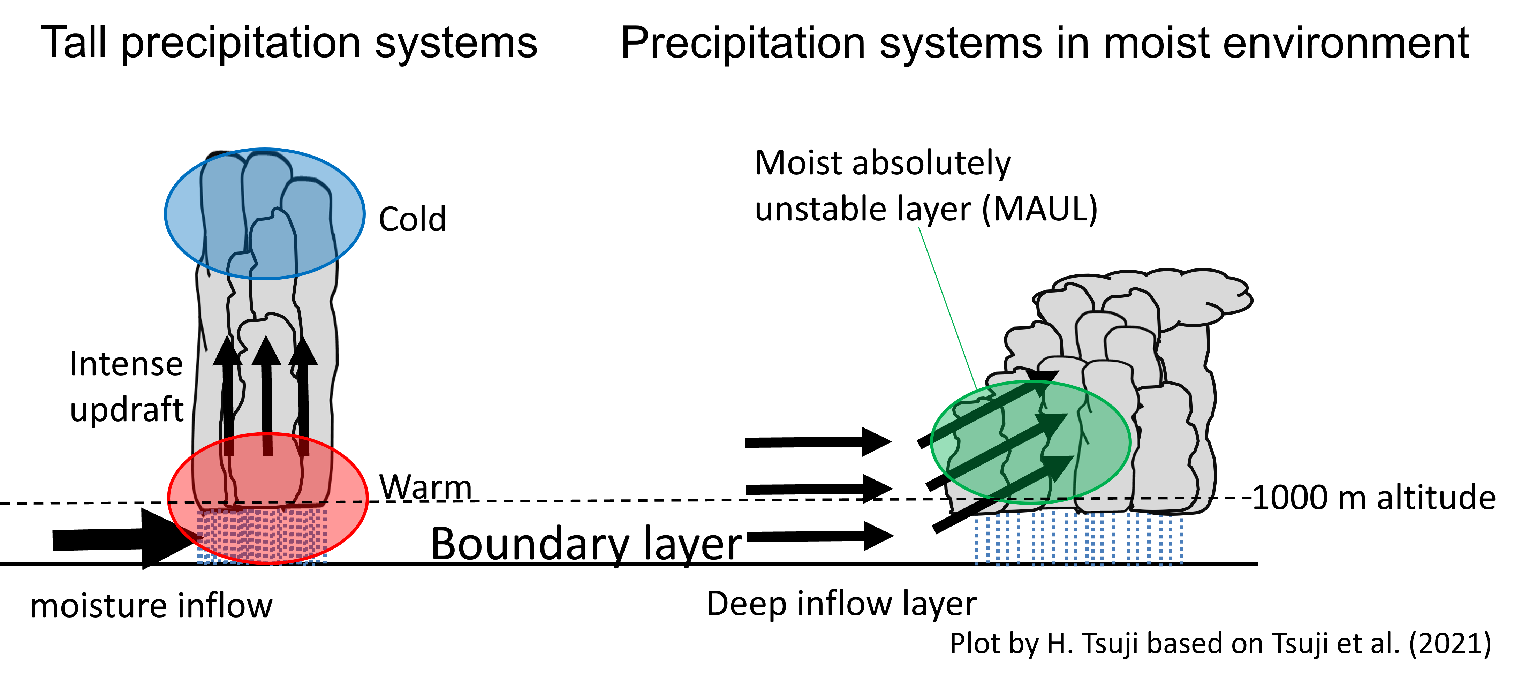
Knowledge from recent studies on heavy rainfall around Japan
Heavy rainfall is often brought by organized precipitation systems in very moist environments in the mid-lower troposphere. It is not necessarily linked to tall thunderstorms. (Hamada et al. 2015; Hamada and Takayabu 2018; Yokoyama et al. 2020; Tsuji et al. 2020, 2021)
A deep inflow layer of moisture in the mid-lower troposphere is essential for maintaining organized precipitation systems through producing MAUL. This mechanism is different from that for tall thunderstorms rooted in a moisture inflow in the boundary layer.
(Tsuji et al. 2021)

Slide 12
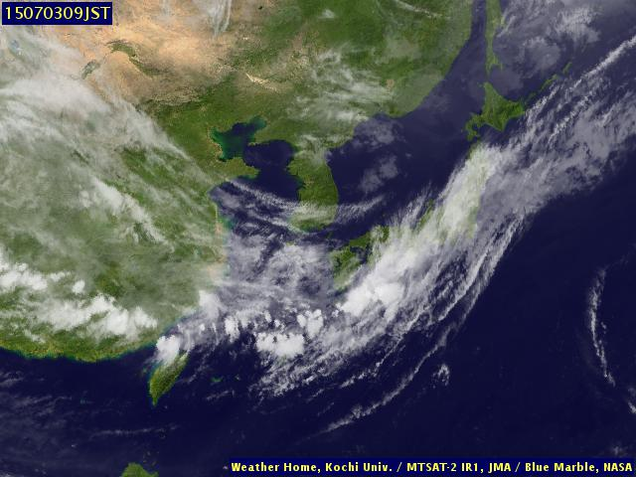
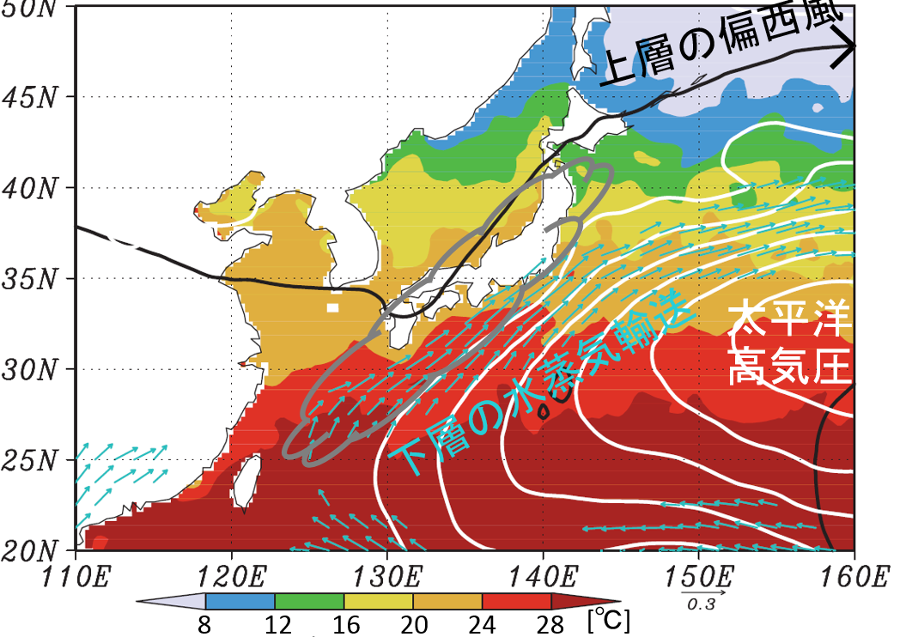
3. Precipitation systems in early summer over East Asia
0Z 3 July 2015
Infrared imagery
Large-scale environment
Subtropical jet
Factors to form Baiu fronts
Subtropical jet (STJ)
Generation of lower-level convective instability (LCI)
H
moisture transport
(e.g., Kodama 1992, 1993)
(quoted from Kochi Univ.)
SST
Baiu/Meiyu/Changma

Slide 13
3-1. Statistical analyses
What are precipitation systems associated with Baiu fronts like?
How are these precipitation characteristics related to STJ and LCI?

Slide 14
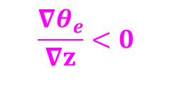
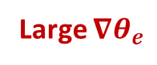
Baiu front (BF): a boundary between the tropics and midlatitudes
Yokoyama et al. (2014)
JRA55 reanalysis
122-135E
June-July (1998-2011)
STJ
Deep convection
Pressure[hPa]
Extratropical cyclones
Θe (color)
u (black contour)
ω (white contour)
Midlatitude air
Subtropical air
North
South
$$\frac{{∇θ}_{e}}{∇z}<0$$
Large $∇θ_{e}$
BF
More convectively unstable

Slide 15
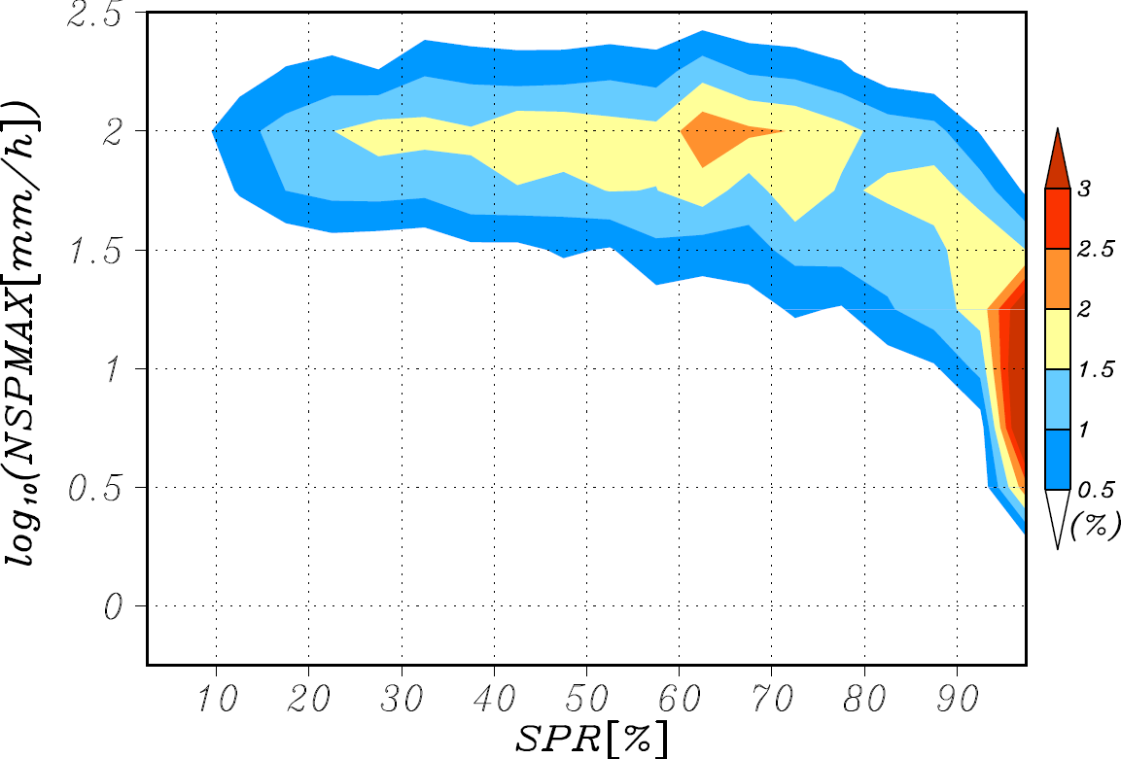
Two types of large (>~3000km²) PEs
Yokoyama et al. (2014)
TRMM PR
122-145E June-July (2002-2014)
Large PEs with SPR<80%
GPM KuPR
Frequency of large PEs to the south of the STJ
Tropical,
organized
316
Extratropical,
highly stratiform
100
31.6
Maximum near-surface precipitation rate[mm/h]
10
Large PEs with SPR≥80%
3.16
1
0
10
20
30
40
50
60
70
80
90
100
80%
Stratiform precipitation ratio[SPR; %]

Slide 16
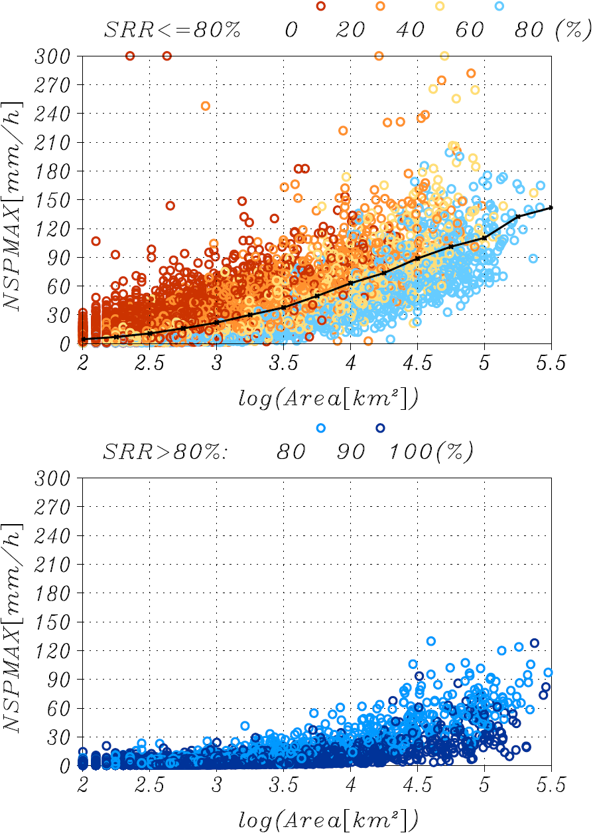
What kind of PEs can be strong?
TRMM PR
122-145E June-July (2002-2014)
SPR[%] 0-20 20-40 40-60 60-80
300
Strongest
240
180
Precipitation systems can produce strong rainfall through mesoscale organization.
Maximum near-surface precipitation rate[mm/h]
120
60
0
100
1000
10000
100000
Area[km²]
Intensity:
Small convective PEs < large PEs with SPRs of 60-80% < large PEs with SPRs of 20-60%

Slide 17
Identified three types of PEs
Yokoyama et al. (2019)
GPM DPR May-July (2014-2017) 120E-180, 20-50N
①Small type
②Organized type
③Midlatitude type
(e.g., localized heavy shower)
(e.g., widespread heavy rainfall)
(e.g., rainfall associated with extratropical cyclone )
~500km
~850km
Area＜ 10^{3.5} (~3000) km²
Area≥10^{3.5} km²
Area≥10^{3.5} km²
SPR＜80%
~1500km
SPR≥80%

Slide 18
Different environments favorable for small and organized types
Yokoyama et al. (2017)
TRMM PR 122-145E June-July (2002-2014)
Rainfall contribution
Difference (organized minus small)
unstable
LCI[K/hPa]
Small type
LCI[K/hPa]
Organized type
STJ strength[m/s]
STJ strength: daily u200 averaged over 122.5-145E
LCI: (Θe_{1000hPa}-Θe_{700hPa})/(1000-700hPa)
STJ strength[m/s]
[%]
Small type dominates
Organized type dominates
Small-type PEs are related to unstable conditions, while organized-type PEs are largely affected by upper-tropospheric large-scale circulations.

Slide 19
How does the STJ affect organized-type PEs?
Yokoyama et al. (2017)
TRMM PR
June-July (2002-2014)
Divergence of Q vector (dynamical forcing) 400-600hPa
Rainfall of organized-type PEs
q@600hPa
Strong STJ
(50-60m/s)
Promote organization
Forced ascent to the south of STJ
Moisten the mid-troposphere
Weak STJ
(20-30m/s)
ascent
descent
The STJ plays a role in moistening the mid-troposphere owing to dynamically-forced ascent to the south of the STJ, producing environments favorable for organized precipitation.
U200 (black contour)
LCI (purple contour)

Slide 20
3-2. A case study on an organized precipitation system
“The heavy rainfall event in July 2018” occurred over a wide area of Japan during July 5-8, 2018, causing tremendous damages across several regions.
What kind of precipitation system brought such heavy rainfall and how the system was maintained?

Slide 21
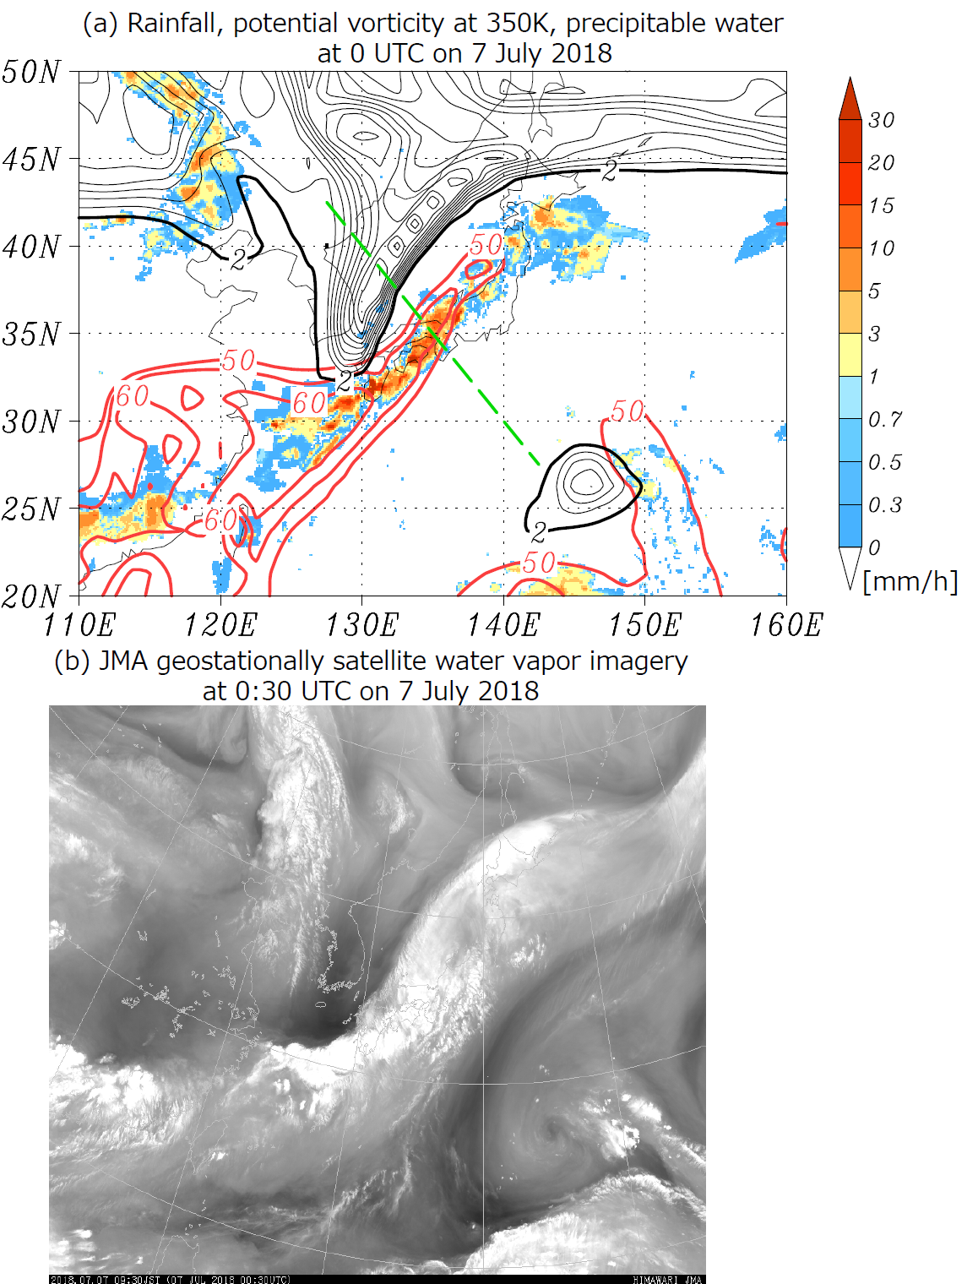
A stagnant upper-tropospheric trough over Korean Peninsula
Yokoyama et al. (2020)
0Z 7 July 2018
GSMaP Rainfall (shades)
JRA55 PV@350K (black contour), precipitable water (red contour)
Water vapor imagery
Deep narrow trough
(provided by JMA)
An extensive rainfall band appeared along the leading edge of the upper-tropospheric trough emerged as a result of the meandering STJ, where precipitable water was extremely large.

Slide 22
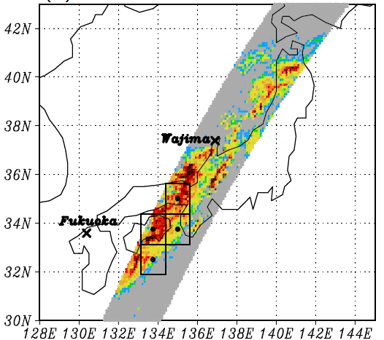
Precipitation characteristics and thermodynamics
Yokoyama et al. (2020)
GPM/DPR 0:35–0:40Z July 7 2018
22km
JRA55 thermodynamics 0Z July7 2018
W-Japan
Θe anomaly
q anomaly
10km
Total
Convective
Stratiform
Sum of rainfall[mm/h]
Sum of rainfall[mm/h]
1 10 100
Near-surface rainfall rate[mm/h]
Precipitation top height[km]
Strat/Conv rainfall ratio=65:35
GPM/DPR shows characteristics of organized precipitation systems.
Relatively low precipitation tops (mostly <10km)
Predominance of stratiform precipitation (SPR=65%)
Relatively stable compared to the climatology and very humid throughout the troposphere

Slide 23
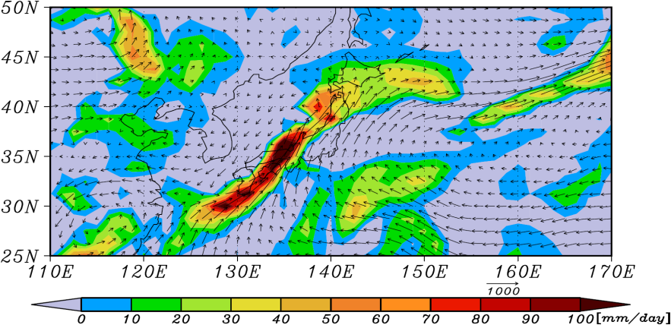
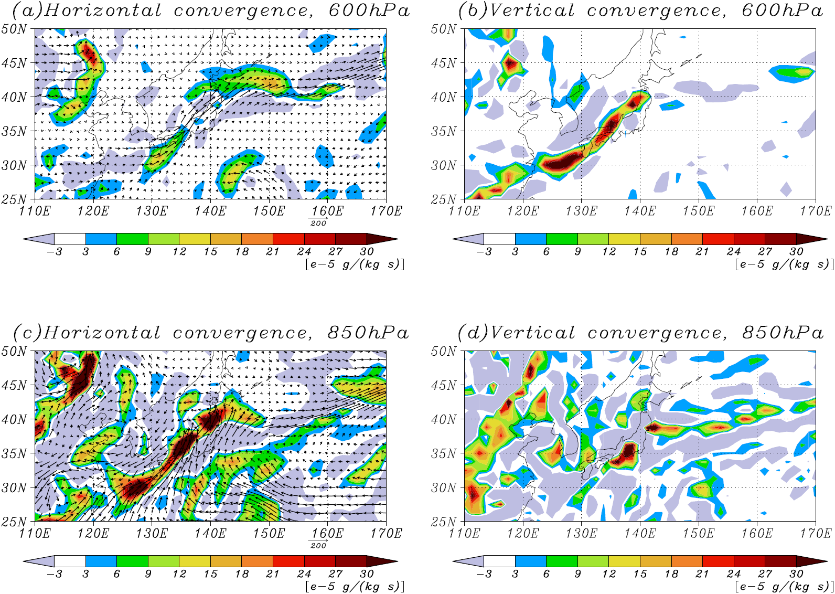

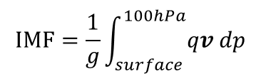
Moisture flux convergence
Yokoyama et al. (2020)
JRA55 0Z 7 July 2018
Large vertical moisture flux convergence in the mid-troposphere
Integrated moisture flux (IMF) convergence
Horizontal moisture flux convergence
Vertical moisture flux convergence
600hPa
$$IMF=\frac{1}{g}\int_{surface}^{100hPa}{qv dp}$$
850hPa
IMF convergence was very large to the front of the upper-tropospheric trough.
Large horizontal moisture flux convergence in the lower troposphere (southwesterly and southerly)
Water vapor is advected by the horizontal flux in the lower troposphere and lifted by ascent on the front of the trough.

Slide 24
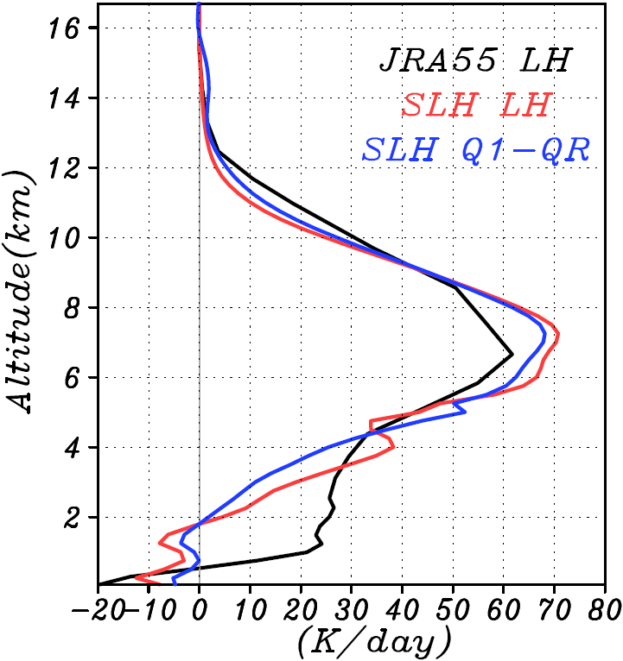
Contributions to ω from dynamical & diabatic forcing
Yokoyama et al. (2020)
GSMaP rainfall (shades), JRA55 ω@500hPa (black contour)
Quasi-geostrophic ω eq. (Holton 2004)
Mean LH (W-Japan)
A
JRA55 LH
GPM SLH(LH)
GPM SLH(Q_{1R})
Dynamical forcing
Diabatic forcing
B
JRA55 LH
(~GPM SLH)
dynamical ω@500hPa
descent
12Z 6 July 2018
Vertical moisture flux convergence (ー∂qω/∂p)
Quasi-geostrophic ω
dynamical ω
diabatic ω
Two peaks@650&400hPa
Significant peak@400hPa
ascent
diabatic ω@500hPa
Pressure[hPa]
descent
A
B
A
B
A
B
Dynamically-forced ascent associated with the upper-tropospheric trough contributes to the moistening of the mid-troposphere.
ascent

Slide 25
Precipitation organized in association with upper-tropospheric circulations
Yokoyama et al. (2020)
Dynamically-forced ascent associated with an upper-tropospheric trough
Moistening of the mid-lower troposphere
Organization of precipitation
Horizontal moisture flux
The synergy between dynamical effects associated with the upper-tropospheric trough and diabatic effects associated with precipitation promoted conditions favorable for the organization of precipitation in this heavy rainfall event.

Slide 26
3. Precipitation systems with quasi-stationary convective bands (QSCBs) around Japan in the warm season
QSCBs (so-called “線状降水帯” in Japanese) continue to bring rainfall at the same place and often cause terrible damage.
What kind of PEs and large-scale environments are related to QSCBs?

Slide 27
Summary
The 3D-dimensional observation of precipitation by Spaceborne radars is useful for understanding the mechanisms of precipitation systems.
In the Baiu region, two tropical types (small and organized) and a midlatitude type of precipitation systems are identified.
The synergy between the dynamical forcing associated with the secondary circulation of the upper-tropospheric circulations and the release of latent heat associated with precipitation provides a sufficiently moist mid-lower layer, which maintains the organization of precipitation.
Many of the QSCBs are also associated with organized precipitation systems in sufficiently moist environments in the mid-lower layers. The stronger and longer QSCBs are associated with intense convection in addition to large stratiform areas in organized precipitation systems. It is suggested that the wetting process of the mid-troposphere is the key for understanding the mechanisms.
Thank you very much for your listening!

